Slide 1

Active Computational Multispectral Imaging Technology
(ACMIG)
答辩人：严笑凯
Reporter：Yuanzhuo Niu
：
Teacher：Lei Zhang
Time：19/12/2023

Slide 2
01
Research Background
02
Related Work
CONTENTS
03
Research Work
04
Research Solution
05
Research Progress

Slide 3
1
Research Background

Slide 4
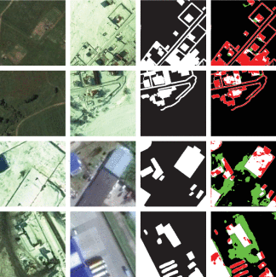
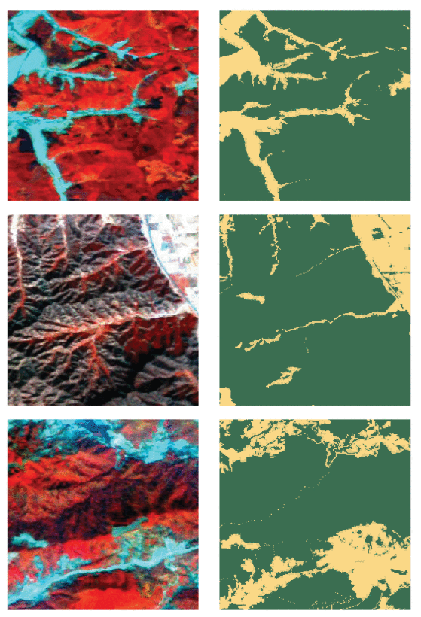
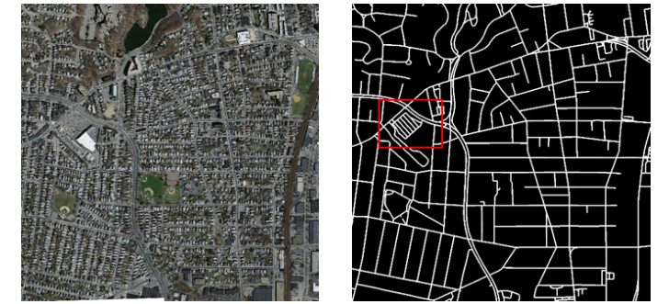
RB
RW
RW
RS
RP
Compared with traditional RGB images, hyperspectral images can not only preserve the spatial information of the scene, but also the rich spectral information of the scene. More dimensional data provide better support for downstream tasks. However, it is the increase in dimensionality that makes it difficult to ensure real-time imaging of hyperspectral images, thus limiting their performance in many downstream tasks.

Slide 5
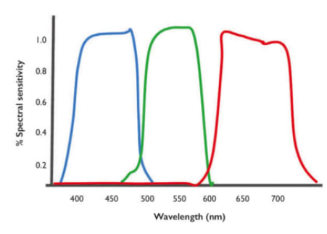
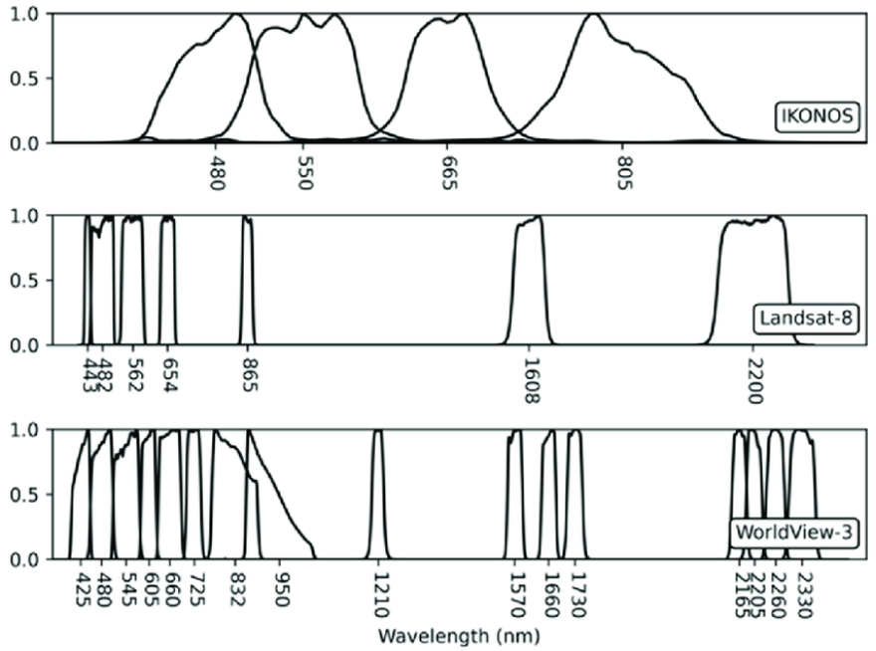
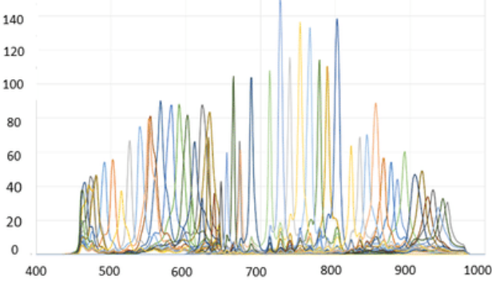
RB
RW
RW
RS
RP
However, current imaging techniques for RGB, multispectral and hyperspectral scenes integrates the spectrum in the visible range into three discrete bands, i.e., red, green, and blue, full-bandwidth into 3-10 or more discrete bands respectively, all based on the Spectral Response Function (SRF).

Slide 6
RB
RW
RW
RS
RP
Our Goal
Cameras | RGB | My Multispectral | Hyperspectral
Spectral Dimension | 3 | 3-10 | 10+
SRF | fixed | Learnable and Changeable | fixed
Liquid Crystal Tunable Filter (LCTF) ensures the experimental changeability of SRF

Slide 7
2
Related Work

Slide 8
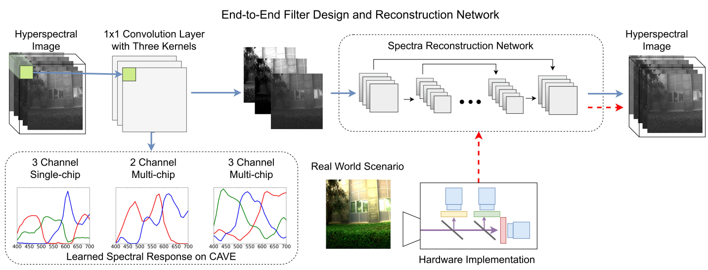
RB
RW
RW
RS
RP
Deeply Learned Filter Response Functions for Hyperspectral Reconstruction
SRF is learnable in training, but unchangeable in testing
LOGO

Slide 9
3
Major Research Work

Slide 10
RB
RW
RW
研究方案
研究进展
Make SRF Changeable in testing: Hardware

Slide 11
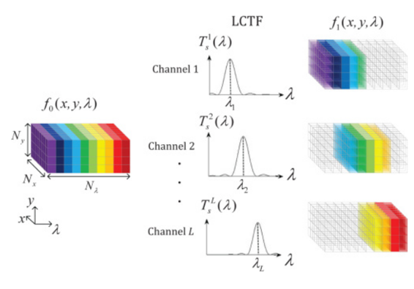
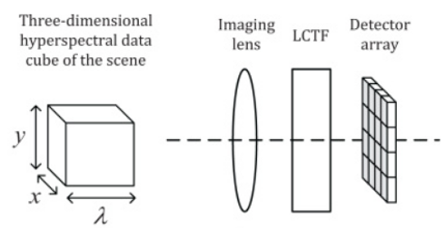
研究背景
相关工作
研究内容
研究方案
研究进展
LCTF is an optical filter that uses electronically controlled liquid crystal elements to transmit a selectable wavelength of light and exclude others. In order to obtain the hyperspectral data cube across multitudes of wavelengths, the scene is spectrally scanned by tuning the center wavelength of the LCTF.

Slide 12
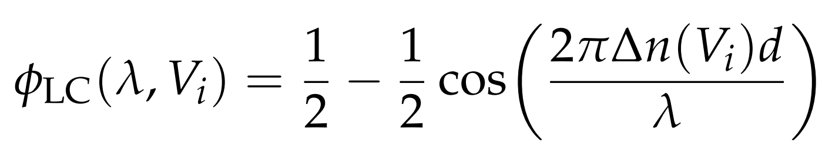
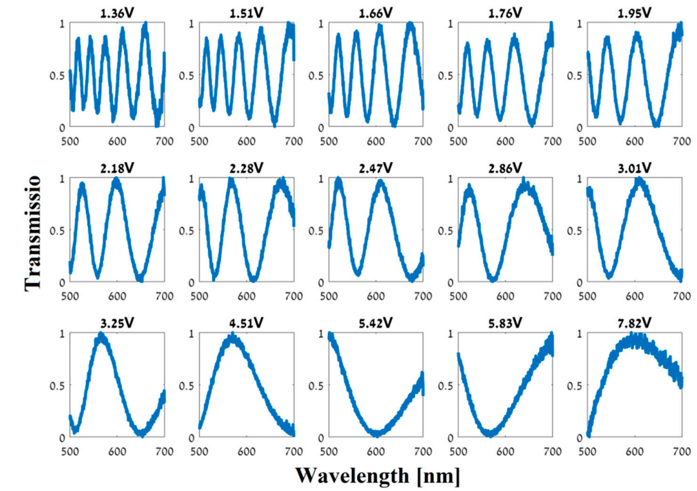
研究背景
相关工作
研究内容
研究方案
研究进展
The SRF Function of LCTF
Measured spectral responses (intensity transmission vs. wavelength in nm) of the fabricated LC phase retarder. Each graph represents the spectral modulation with a different voltage applied on the LC cell (15 different voltages)

Slide 13
研究背景
相关工作
研究内容
研究方案
研究进展
Choose a Field and Baseline:
Hyperspectral Classification (HIS)

Slide 14
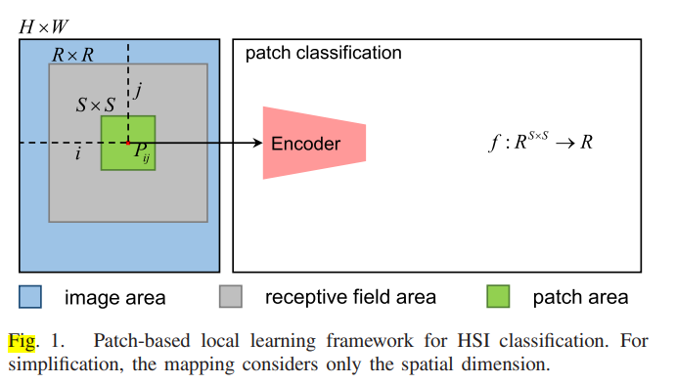
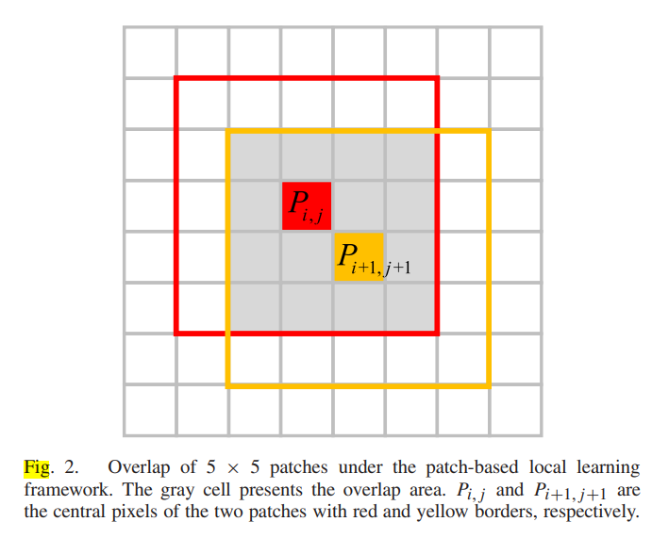
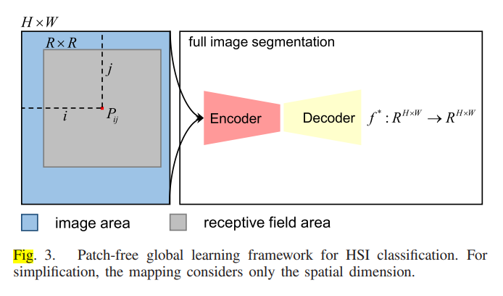
研究背景
相关工作
研究内容
研究方案
研究进展
cons
Local learning
High Computation Cost
Major setting in HSI
Unmatched with our research setting
pros
cons
FPGA
Matched with our research setting
Global Learning
Unable to converge
Low Computation Cost
LOGO

Slide 15
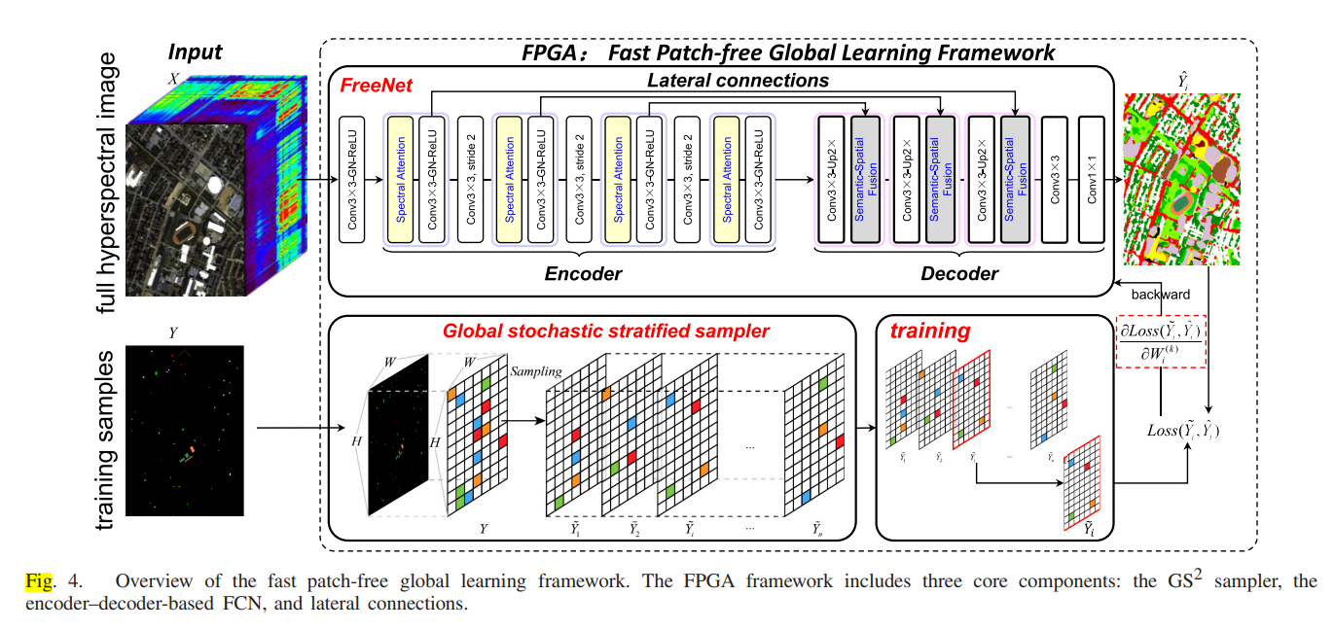
研究背景
相关工作
研究内容
研究方案
研究进展
FPGA: Fast Patch-Free Global Learning Framework for Fully End-to-End Hyperspectral Image Classification
LOGO

Slide 16
4
Research Solution

Slide 17
研究背景
相关工作
研究内容
研究方案
研究进展
Make SRF Changeable in testing: Software

Slide 18
研究背景
相关工作
研究内容
研究方案
研究进展
FPGA HIS Baseline
Img-wise Adaptive
HI
(N*M)
1*3
Volumes
LCTF SRF
N*3
In
Out
params
img
Temp variables
LOGO

Slide 19
研究背景
相关工作
研究内容
研究方案
研究进展
Out
Pixel-wise Adaptive
N*3
mul
HI
(N*M)
1*3
Volumes
LCTF SRF
N*3
Dynamic Convolution Kernal
（1*1）
N*3*3
In
params
img
Temp variables
LOGO

Slide 20
5
Research Progress

Slide 21
研究背景
相关工作
研究内容
研究方案
研究进展
 | IP | PU | SV | DC | HU2018
波段范围（nm） | 400-2500 | 430-860 | 400-2500 | 400-2400 | 380-1050
光谱分辨率 | 9.374nm | 4nm | 9.375nm | 10nm | 13.4nm
空间分辨率(m) | 20 | 1.3 | 3.7 | 3 | 1
空间大小 | 145 145 | 610 340 | 512 217 | 1280 307 | 2384 304
剩余光谱数 | 200 | 103 | 204 | 191 | 50
原始光谱数 | 224 | 115 | 224 | 191 | 50
360
LOGO

Slide 22
研究背景
相关工作
研究内容
研究方案
研究进展
Experiment in traditional setting (pResNet)
LOGO

Slide 23
研究背景
相关工作
研究内容
研究方案
研究进展
10patches windowsize=5
 | IP | PU | SV | DC | UH2018
baseline | 55.812 | 74.142 | 87.118 | 95.226 | 46.352
3通道cave | 43.702 | 69.964 | 82.34 | 88.42 | 39.706
3通道积分srf | 41.23 | 66.596 | 81.224 | 86.6 | 40.124
3通道电压 | 42.212 | 68.966 | 80.324 | 94.154 | 42.058
5通道电压 | 42.228 | 69.386 | 81.846 | 94.282 | 41.788
OA
 | IP | PU | SV | DC | UH2018
baseline | 55.812 | 74.142 | 87.118 | 95.226 | 46.352
3通道cave | 43.702 | 69.964 | 82.34 | 88.42 | 39.706
3通道积分srf | 41.23 | 66.596 | 81.224 | 86.6 | 40.124
3通道电压 | 42.212 | 68.966 | 80.324 | 94.154 | 42.058
5通道电压 | 42.228 | 69.386 | 81.846 | 94.282 | 41.788
AA
 | IP | PU | SV | DC | UH2018
baseline | 55.812 | 74.142 | 87.118 | 95.226 | 46.352
3通道cave | 43.702 | 69.964 | 82.34 | 88.42 | 39.706
3通道积分srf | 41.23 | 66.596 | 81.224 | 86.6 | 40.124
3通道电压 | 42.212 | 68.966 | 80.324 | 94.154 | 42.058
5通道电压 | 42.228 | 69.386 | 81.846 | 94.282 | 41.788
KAPPA
LOGO

Slide 24
研究背景
相关工作
研究内容
研究方案
研究进展
10patches windowsize=1
OA
 | IP | PU | SV | DC
baseline | 53.32 | 65.96 | 82.75 | 86.73
3通道cave | 32.50 | 67.56 | 78.39 | 80.90
3通道learnable srf/SRF 电压 | 38.49 /38.25 | 65 /65.32 | 79.52 /77.68 | 88.29 /84.11
RGB
needs windowsize
 | IP | PU | SV | DC
baseline | 64.516 | 72.22 | 88.31 | 91
3通道cave | 39.86 | 65.27 | 84.37 | 76.49
3通道learnable srf/SRF 电压 | 48.71 /47.74 | 67.22 /65.62 | 86.17 /81.41 | 86.60 /86.16
AA
 | IP | PU | SV | DC
baseline | 47.52 | 56.71 | 80.77 | 81.99
3通道cave | 25.37 | 57.05 | 76.05 | 72.88
3通道learnable srf/SRF 电压 | 31.86/31.54 | 55.18/55.31 | 77.25/75.12 | 83.57/77.67
KAPPA
LOGO

Slide 25
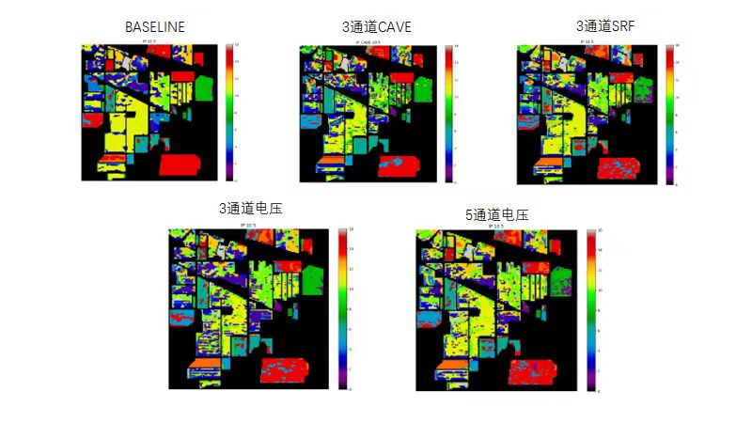
研究背景
相关工作
研究内容
研究方案
研究进展
LOGO

Slide 26
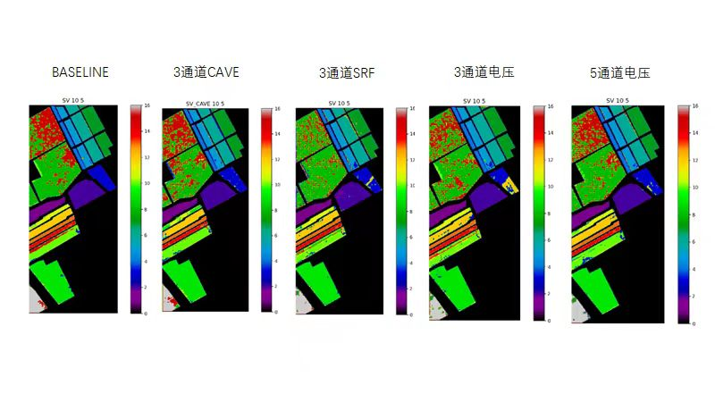
研究背景
相关工作
研究内容
研究方案
研究进展
LOGO

Slide 27
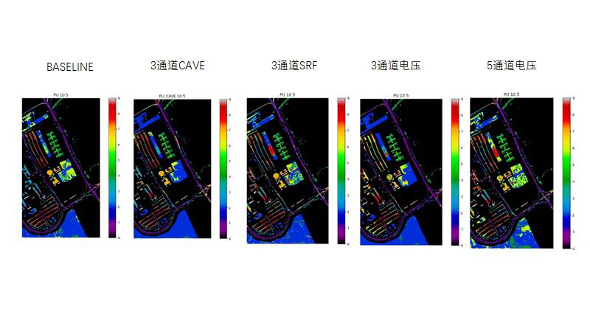
研究背景
相关工作
研究内容
研究方案
研究进展
LOGO

Slide 28
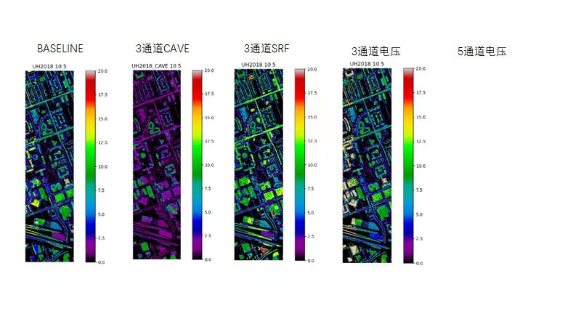
研究背景
相关工作
研究内容
研究方案
研究进展
LOGO

Slide 29
研究背景
相关工作
研究内容
研究方案
研究进展
Experiment in proper setting (FPGA)
LOGO

Slide 30
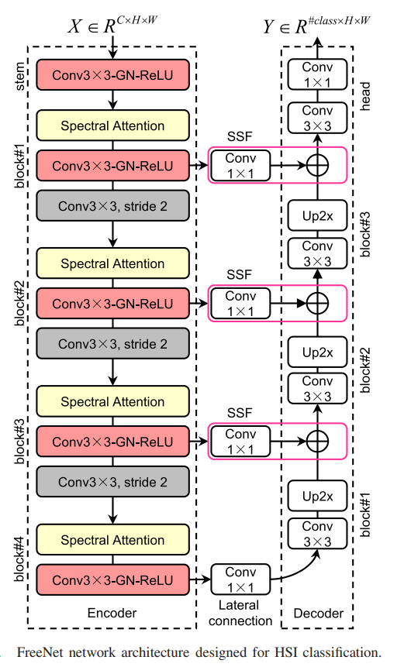
研究背景
相关工作
研究内容
研究方案
研究进展
(Ytarget , Xhsi)
Encoder
Cross
Entropy
Decoder
Decoder
MRAE
分类头
重建头
Ypred
Xconstruct
LOGO

Slide 31
研究背景
相关工作
研究内容
研究方案
研究进展
OA
数据集 | IP baseline可见光 |  |  |  | IP baseline全波段
训练集 | 20 | 10 | 5 | 1 | 20 | 10 | 5 | 1
baseline | 0.3846038 | 0.4103824 | 0.406432 | 0.3587236 | 0.433173 | 0.4129654 | 0.3968094 | 0.377412
3通道cave | 0.3991896 | 0.3833536 | 0.3967078 | 0.3318308 | 0.3991896 | 0.3833536 | 0.3967078 | 0.3318308
3通道srf |  |  |  | 0.3301092
3通道电压 |  |  |  | 0.3815146
5通道电压 |  |  |  | 0.376247
10通道电压 |  |  |  | 0.3830842
3通道重建AD |  |  |  | 0.3314256
5通道重建AD |  |  |  | 0.3729046
LOGO

Slide 32
研究背景
相关工作
研究内容
研究方案
研究进展
OA
数据集 | IP baseline可见光 | IP baseline全波段 | PU baseline可见光 | SV baseline可见光 | DC baseline可见光 | DC Baseline全波段 | HU18 baseline可见光
训练集 | 1 | 1 | 1 | 1 | 1 | 1 | 1
baseline | 0.3587236 | 0.377412 | 0.4510914 | 0.3987604/ 0.7139596 | 0.3972836 | 0.6037002 | 0.2019074/ 0.112385
3通道cave | 0.3318308 | 0.3318308 | 0.3996224 | 0.3438268 | 0.4123184 |  | 0.1326178
3通道srf | 0.3301092 |  | 0.4030766 | 0.401318 |  |  | 0.1308084
3通道电压 | 0.3815146 |  | 0.3759 | 0.2753174/ 0.3809344 |  |  | 0.1093098
5通道电压 | 0.376247 |  | 0.3802016 | 0.215465/ 0.4078702 |  |  | 0.1138782
10通道电压 | 0.3830842 |  | 0.41341 | 0.1891784/ 0.5034138 |  |  | 0.1199234
3通道重建AD | 0.3314256 |  | 0.426849 | 0.2497194 |  |  | 0.0914414
5通道重建AD | 0.3729046 |  | 0.3835558 | 0.278564 |  |  | 0.092702
LOGO

Slide 33
研究背景
相关工作
研究内容
研究方案
研究进展
OA
数据集 | PU baseline可见光 |  |  |  | SV baseline可见光 |  |  |  | dc baseline可见光 |  |  |  | HU18 baseline可见光
训练集 | 20 | 10 | 5 | 1 | 20 | 10 | 5 | 1 | 20 | 10 | 5 | 1 | 20 | 10 | 5 | 1
baseline | 0.96399 | 0.902141 | 0.789573 | 0.565836 | 0.971265 | 0.928422 | 0.861046 |  | 0.9911376 | 0.988860 | 0.964896 |  | 0.612134 | 0.5082144
3通道cave | 0.94360 | 0.859061 | 0.755872 | 0.548980 | 0.946812 | 0.890712 | 0.842332 |  | 0.9652186 | 0.920262 | 0.865973 |  | 0.555741 | 0.461449
AA
数据集 | PU baseline可见光 |  |  |  | SV baseline可见光 |  |  |  | dc baseline可见光 |  |  |  | HU18 baseline可见光
训练集 | 20 | 10 | 5 | 1 | 20 | 10 | 5 | 1 | 20 | 10 | 5 | 1 | 20 | 10 | 5 | 1
baseline | 0.97047 | 0.9175016 | 0.8190484 | 0.5270256 | 0.985003 | 0.9588936 | 0.9061334 |  | 0.9964772 | 0.9942512 | 0.9821604 |  | 0.799311 | 0.7258372
3通cave | 0.95642 | 0.8926256 | 0.7984776 | 0.529321 | 0.9674168 | 0.9355808 | 0.8970546 |  | 0.9846368 | 0.9596632 | 0.9102252 |  | 0.759437 | 0.6908656
KAPPA
数据集 | PU baseline可见光 |  |  |  | SV baseline可见光 |  |  |  | dc baseline可见光 |  |  |  | HU18 baseline可见光
训练集 | 20 | 10 | 5 | 1 | 20 | 10 | 5 | 1 | 20 | 10 | 5 | 1 | 20 | 10 | 5 | 1
baseline | 0.959439 | 0.872679 | 0.729333 | 0.439108 | 0.968067 | 0.920738 | 0.850826 |  | 0.987231 | 0.983979 | 0.9500744 |  | 0.543230 | 0.438363
3通cave | 0.926340 | 0.818578 | 0.687889 | 0.421645 | 0.940934 | 0.879096 | 0.826172 |  | 0.950681 | 0.889378 | 0.8165364 |  | 0.486730 | 0.393501
LOGO

